Slide 1
System Analysis and Design
Unit 1: Managing the information system project

Slide 2
Managing the information system project
Throughout SDLC, project manager is responsible for initiating, planning, executing, and closing down the project
project management is an important aspect of an information systems development project and critical skill for system analyst
ensure projects meet customer expectations and are delivered within budget and time constraints.
A project is a planned process undertaking of a series of related activities to reach an objective that has a beginning and an end.
project should have a balance between cost, scope, and time.

Slide 3
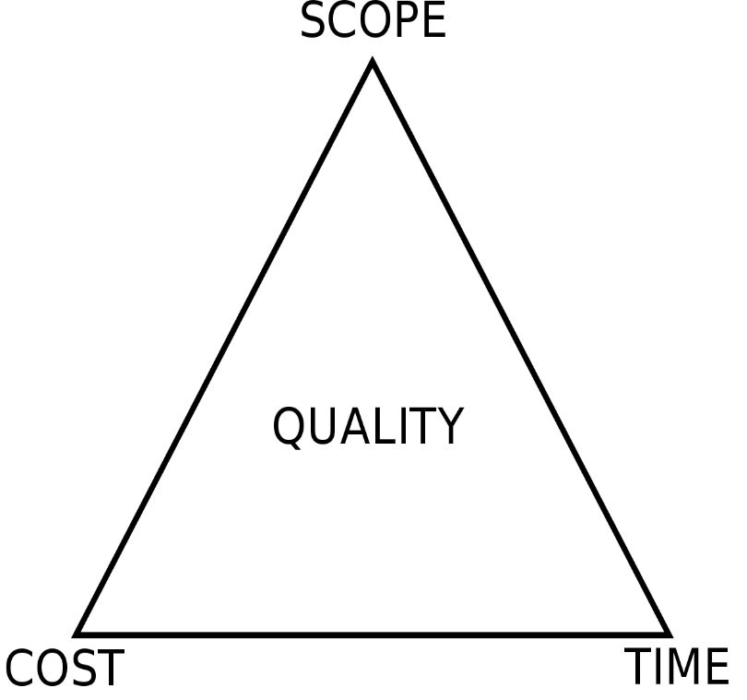
Fig: Project Triangle includes cost, scope and time

Slide 4
Project Manager
is a systems analyst with a diverse set of skills - management, leadership, technical, conflict management, and customer relationship
responsible for initiating, planning, executing, and closing down a project.
environment always changes and problem arises.
So, Creating and implementing successful projects requires managing the resources, activities, and tasks needed to complete the information systems project.

Slide 5
Activities and Skills of Project Manager
1. Leadership
Influencing the activities of others
Communication
Liaison between management users, and developers;
assigning activities
monitoring progress
2. Management
Getting projects completed utilizing resources
Defining and sequencing activities
communicating expectations
assigning resources to activities
monitoring outcomes

Slide 6
3. Customer relations
Working closely with customers ensure that project meet expectations
Interpreting system requests specifications
site preparation
user training
contact point for customers
4. Technical problem solving
defining activities and their sequence
designing solutions to problems
making trade-offs between alternative solutions

Slide 7
5. Conflict management
Managing conflict within a project team
Problem solving
smoothing out personality differences;
compromising
goal setting
6. Team management
Managing the project team for effective team performance
Communication within and between teams
peer evaluations
conflict resolution
team building
self-management

Slide 8
7. Risk and change management
Identifying, assessing, and managing the risks and day-to-day changes that occur during a project
Environmental scanning
Risk and opportunity identification and assessment
Forecasting
resource redeployment

Slide 9
Phases of Project Management
Project management is a controlled process of initiating, planning, executing, monitoring controlling, and closing down a project
Initiating:
project is conceptualized and feasibility is determined.
defining the project goal
defining the project scope
identifying the project manager and key stakeholders
identifying potential risks
producing an estimated budget and timeline.

Slide 10
2. Planning
creating a blueprint to guide the entire project from ideation through completion.
This blueprint will map out the
project's scope;
resources required to create the deliverables;
estimated time and financial commitments;
communication strategy ensuring stakeholders are kept up to date and involved;
execution plan; and
proposal for ongoing maintenance.
If the project has not yet been approved, this blueprint will serve as a critical part of the pitch.

Slide 11
3. Executing
Locating resources required for the project as well as staff the team.
requires effective management of the team members on the ground.
are responsible for delegating and overseeing the work on the project
maintaining good relationships with all team members
keeping the entire project on time and on budget.
address team concerns and any issues that arise along the way,
Conducting frequent and open communication with all team members and stakeholders.

Slide 12
4. Monitoring and control
measure the progress of the project to ensure it is developing properly.
Documentation such as data collection and verbal and written status reports may be used.
Monitoring and controlling is closely related to project planning.
While planning determines what is to be done, monitoring and controlling establish how well it has been done.
Monitoring will detect any necessary corrective action or change in the project to keep the project on track.

Slide 13
5. Closing
occurs once the project deliverables have been produced and the stakeholders validate and approve them.
During this phase, the project manager will close contracts with suppliers, external vendors, consultants, and other third-party providers.
All documentation will be archived and a final project report will be produced.
Now final parts of the project plan - plan for troubleshooting and maintenance.

Slide 14
Representing and Scheduling Project Plans
A project manager has a wide variety of techniques available for depicting and documenting project plans.
documents can be graphical or textual reports
although graphical reports have become most popular for depicting project plans.
The most commonly used methods are
Gantt charts
Network diagrams

Slide 15
Gantt chart
Network diagram
Shows only beginning and end of task
Only shows the duration of tasks
shows the time overlap of tasks
Doesn’t show slack times
Eg, bar chart
shows ordering of activities by connecting a task to its predecessor and successor tasks
shows the sequence dependencies between tasks.
show which tasks could be done in parallel.
Shows slack times
Eg, flow chart

Slide 16
Eg of Gantt chart- Project management software - excel
task | start date | days to complete
task 1 | 22-May | 13
task 2 | 31-May | 9
task 3 | 5-Jun | 9
task 4 | 25-Jun | 14
task 5 | 21-Jun | 9
task 6 | 1-Jul | 5
task 7 | 8-Jul | 7
task 8 | 15-Jul | 12

Slide 17
Question
Task | Start date | duration
1 | 1-jun | 10
2 | 12-jun | 7
3 | 20-jun | 10
4 | 1-jul | 5
5 | 7-jul | 3
6 | 7-jul | 3
7 | 11-jul | 2
8 | 13-jul | 2

Slide 18
Network diagram
most widely used and best-known scheduling methods
is a critical path scheduling technique used for controlling resources.
A critical path refers to a sequence of task activities whose order and durations directly affect the completion date of a project.
Has the ability to represent how completion times vary for activities.
Because of this, it is more often used than Gantt charts to manage projects

Slide 19
Eg, activity schedule
Tasks | Immediate Predecessor | Estimated time
A | - | 7
B | - | 9
C | A | 12
D | A, B | 8
E | D | 9
F | C, E | 6
G | E | 3
﻿1. Construct a project
2. Perform forward and backward passes
3. Determine project completion time
4. Calculate slack values
5. State critical path

Slide 20
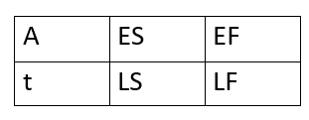
Solution:
Formula
Where,
A- is activity being described
t- represents expected activity time/duration
ES- earliest time an activity can start
EF- earliest finish time
LS- latest start time
LF- latest finish time

Slide 21


Slide 22
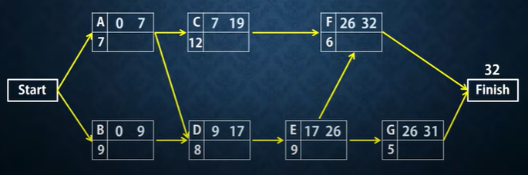
Forward pass
EF= ES+t

Slide 23
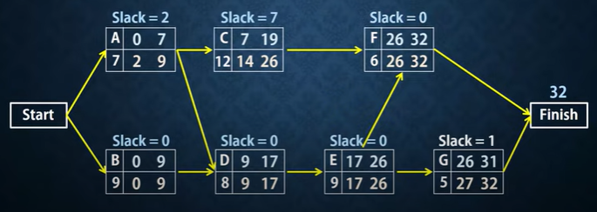
Backward pass
LS= LF-t slack= LF-LS or LS- ES Critical path: B-D-E-F

Slide 24
Question
Tasks | Immediate Predecessor | Estimated time
A | - | 5
B | A | 6
C | A | 6
D | B, C | 2
E | D | 5
F | D | 5
G | F | 3
H | E,G | 1

Slide 25
Calculating Expected time durations using PERT
PERT - Program Evaluation Review Technique
is a technique that uses optimistic, pessimistic, and realistic time estimates to calculate the expected time for a particular task.
helps you to obtain a better time estimate when there is some uncertainty as to how much time a task will require to be completed.
optimistic (o) and pessimistic (p) times reflect the minimum and maximum possible periods of time for an activity to be completed.
The realistic (r) time reflects the project manager’s “best guess” of the amount of time the activity actually will require for completion.

Slide 26

Once each of these estimates is made for an activity, an expected time (ET) can be calculated.
Because expected completion time should be closest to the realistic (r) time, it is typically weighted four times more than the optimistic (o) and pessimistic (p) times.
Once you add these values together, it must be divided by six to determine the ET.
This equation is shown in the following formula:

Slide 27
Where,
ET = expected time for the completion for an activity
o = optimistic completion time for an activity
r = realistic completion time for an activity
p = pessimistic completion time for an activity

Slide 28
example,
suppose that your instructor asked you to calculate an expected time for the completion of an upcoming programming assignment.
For this assignment,
you estimate an optimistic time of two hours,
a pessimistic time of eight hours,
and a most likely time of six hours.
Solution:
O=2, p=8, r= 6
Using PERT, the expected time for completing this assignment is
ET= (2+4*6+8)/6 = 5.67 hours

